Slide 1
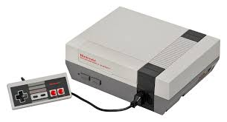
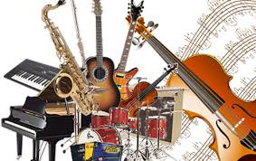
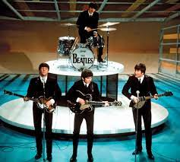
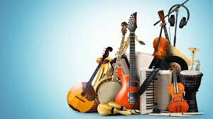
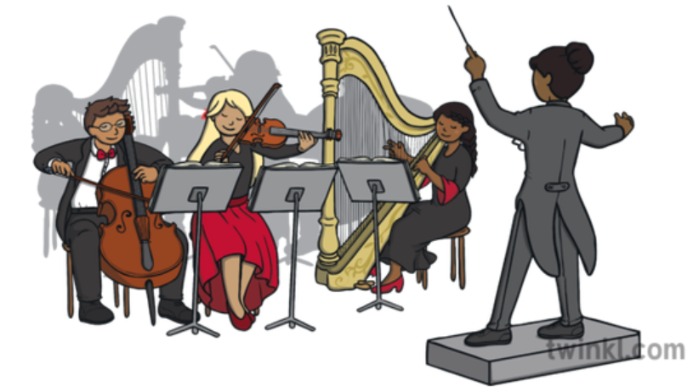
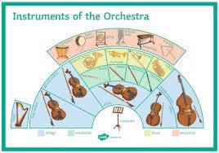
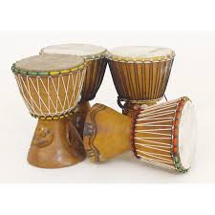
`
THE CLERE SCHOOL
MUSIC LEARNING JOURNEY
LISTENING EXAM
SOLO PERFORMANCE
AOS1: Musical Forms & Devices
Set Work 1:
J.S. Bach’s ‘Badiniere’
ENSEMBLE PERFORMANCE
AOS4: Popular Music
Set Work:
Toto’s ‘Africa’
AOS1: Musical Forms & Devices
Form & Structure
Western Classical Tradition
Melodic & Rhythmic Devices
Chords & Cadences
EDUQAS GCSE MUSIC
COMPOSITION 2
(Set Brief)
AOS3: Film Music
Elements of Music:
common associations
AOS2: Music for Ensemble
Jazz & Blues
Musical Theatre
Chamber Music
COMPOSITION 1
(Free composition)
AOS4: Popular Music
Features & Techniques
Instrumentation & Technology
Structure
Bhangra
Fusion
Compose a soundtrack to a given short animated film
MUSIC FOR COMPUTER & VIDEO GAMES
Melody:
Ground themes
Decision motifs
Instrumentation:
8-Bit music / synthesiser
Sampling
Sound effects
Create original gameplay compose suitable themes and sound effects
YEAR 10&11
Melody:
Leitmotif
Mickey-mousing
Chromaticism
YEAR
PERFORMANCE, COMPOSITION, LISTENING & APPRAISING SKILLS
Instrumentation:
Common associations
Musical cliches
Revisit Musical Elements:
Common associations:
Dynamics
Tempo
Structure
Tonality
Harmonic Analysis:
Analysis of ‘With a Little Help from my Friends’
Instrumentation:
Overdubbing
Synthesised sounds
Music technology
POP MUSIC
(Rock & Roll, EDM, Fusion)
FILM MUSIC
YEAR 9
ENSEMBLE / COMPOSITION SKILLS
Fusion:
Bhangra
Zydeco
Mbaqanga
Melodic Analysis:
Analysis of ‘With a Little Help from my Friends’
Ensemble Performance:
Balance
Arrangement
Structure:
Verse Chorus
Strophic
Timbre:
Articulation
Texture:
Accompaniment – development
MINIMALIST
MUSIC
Developing melody:
Note addition
Note subtraction
Sequence (revisit)
Retrograde
Developing rhythm:
Rhythmic transformation
Augmentation
Diminution
Note addition
Rhythmic and Harmonic devices:
Dotted rhythm
Pedal
(Modulation)
COMPOSING, LISTENING & APPRAISING SKILLS
Developing Harmony:
Accompaniment
Modulations
Melodic devices:
Sequence
Passing notes
Auxiliary notes
Revisit Instrumentation:
Creative combinations
Developing Metre:
Unusual metres
Texture:
Layering
Homophonic
Developing Harmony:
Extended chords (7ths)
Tonic
Subdominant
Dominant
Developing rhythm and notation:
Swing rhythm
Straight rhythm
Vamping
Boogie-Woogie
THEME &
VARIATIONS
BLUES MUSIC
COMPOSITION SKILLS
YEAR
8
Developing Melody:
Blue notes
Improvisation
Phrasing
Tonality:
Constructing a blues scale
(Transposition)
Structure:
12-bar blues
Walking Bass
Extended Binary Form
Baroque Instrumentation:
Harpsichord
Basso Continuo
Understanding Melody:
Ornamentation
Ground Bass
Understanding Harmony:
Constructing chords
Primary chords
Secondary chords
BAROQUE MUSIC
WALTZ MUSIC
Dynamics:
Terraced
PERFORMING, LISTENING & APPRAISING SKILLS
Introduction to texture:
Monophonic
Homophonic
Polyphonic
Structure:
Canon
Ground Bass
Rhythm:
Accent
Oom pah pah accompaniment
Understanding Melody:
Conjunct
Disjunct
Diatonic
Intervals
Texture:
Melody and accompaniment
Structure:
Binary Form
Understanding and aurally recognising different playing techniques
INSTRUMENTS OF THE ORCHESTRA
SAHARAN SOUNDS
YEAR
7
PERFORMANCE SKILLS
YEAR
7
Your MUSIC Journey starts here……
Exploration of the roles of instruments within an orchestra & aural identification
Introduction to families of instruments:
strings
woodwind
brass
percussion
Introduction to structure:
cyclic
call and response
Exploration of traditional instruments:
Membranophones idiophones
aerophones chordophones
Introduction to rhythm and notation: monorhythm biorhythm
polyrhythm
cross rhythms
INTEGRITY • COMMUNITY • RESPECT

