Slide 1
Welcome to Year 7
2020

Slide 2
Class of 2025!

Slide 3
Mr Ben Bond
Head Teacher

Slide 4
You will meet a lot
of new people
Mr Bond – Head Teacher
Ms Wheeler– Head of Year
Your Form Tutors
Mrs Rabehi – Sidown
Mrs Plazar- Cottington
Mr Tejani- Beacon
Mrs Thomas- Ladle

Slide 5
Tutors
The tutors are key figures in the pastoral team and they are your first point of contact with the school.
The best form of contact with tutors is via email, although all staff can be contacted through the school office.
The tutor will also be responsible for academic progress, student welfare and ensuring the smooth running of administration.

Slide 6
Music Lesson Opportunities
We are very proud of the musical talents of many of our students, if you are interested in continuing to pursue your interest or take up the opportunity to learn a new instrument – please contact Mrs Kirton on s.kirton@clere.hants.sch.uk for more information.

Slide 7
Friendship & Bullying
Issues
As a school, we wish to encourage an environment where independence is celebrated and individuals can flourish without fear. Every student has the right to be safe and happy in school and protected when he/she is feeling vulnerable.
All incidents are dealt with independently and will be investigated thoroughly. All parties involved will be spoken to and appropriate action will be taken. Students will be dealt with in accordance to the Anti-Bullying and Behaviour Policies.
‘Pupils are respectful to each other and strongly believe that people should be treated equally, and differences valued.’ (Ofsted 2019)

Slide 8
High Expectations…
Pupils must work hard
Learning must be challenging and modelled / supported
Exemplary behaviour for learning, appearance and conduct

Slide 9
We are on a very exciting journey…
We believe that everyone should achieve great examination results which will allow everyone the very best opportunities for their future.
We encourage all our pupils to go to College and University and the majority of them do.
‘The proportion of pupils who achieve a strong pass in English and mathematics is above national averages for most groups of pupils’. (Ofsted 2019)

Slide 10
We also encourage …
Learning to enjoy wider activities:
sports,
music,
special events, eg. Children in Need
trips in this country and abroad
developing unique talents and gifts
We are a small school, so we know everyone well and can celebrate and share all successes in and out of school.

Slide 11
Equipment
Students should ensure they pack the following items in their bag each day. We have a two week timetable, so it is important to be organised with the correct books for the correct day and week.
Pencil case (writing equipment, ruler, etc.)
Subject exercise books for that day
Calculator
Lunch
A Diary or Planner
A reading book
PE Kit (on PE days)

Slide 12
In September
Year 7 - Monday 7th September
Whole School – Tuesday 8th September

Slide 13
Bonding Day 2020
!
To be confirmed
A chance to get to know each other and work as a team…
Non-uniform
Arrive at school normal time
Bring lunch and drinks

Slide 14
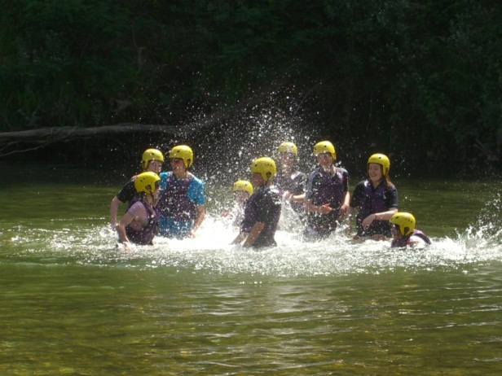
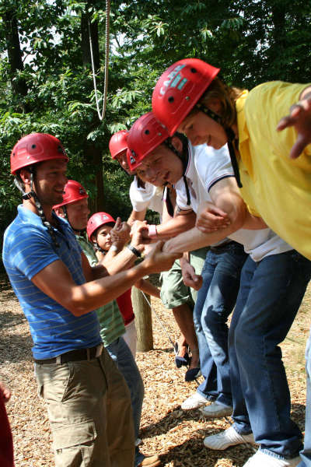
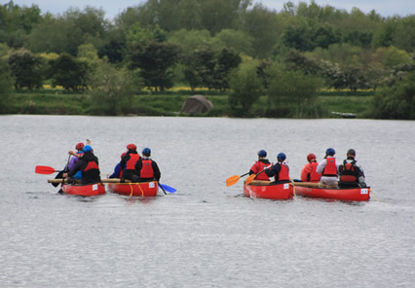
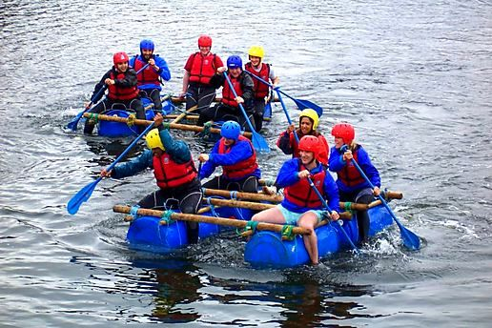
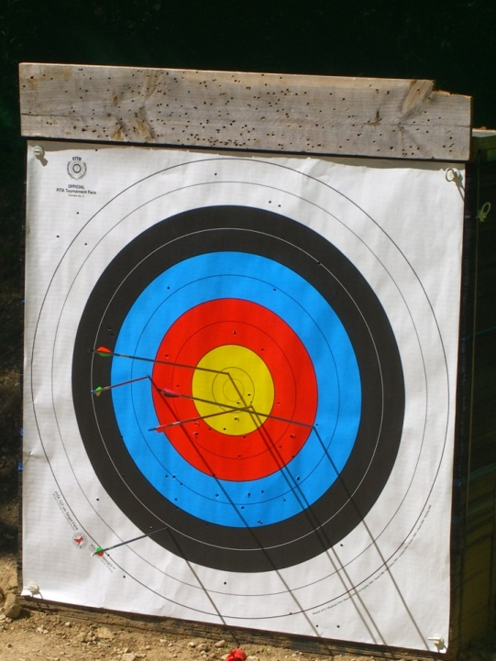
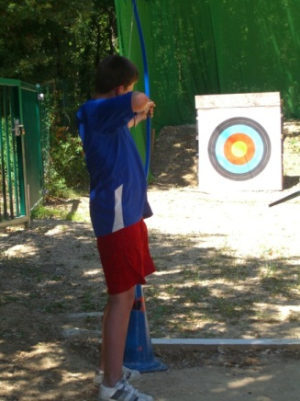
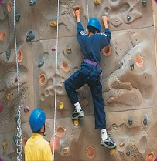
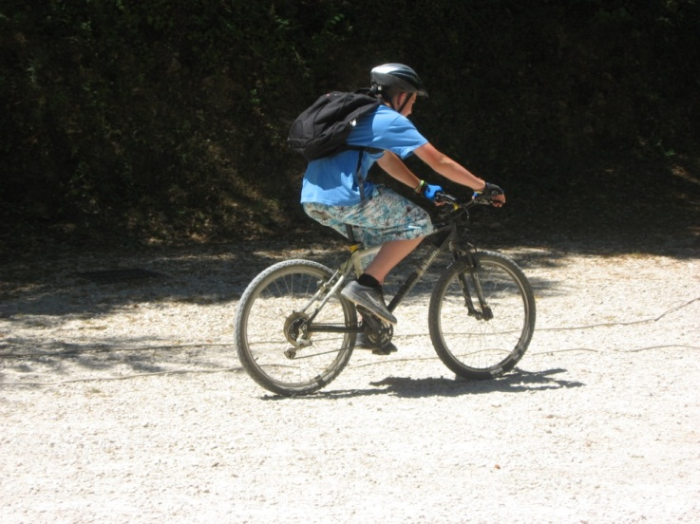
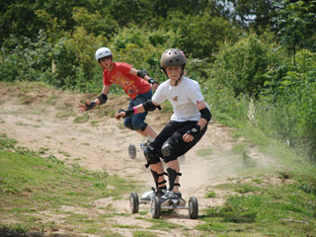
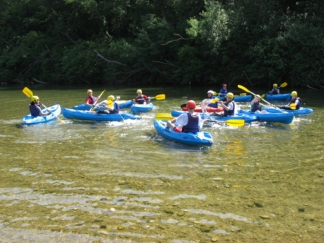
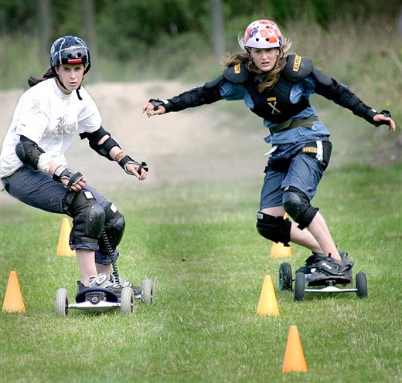
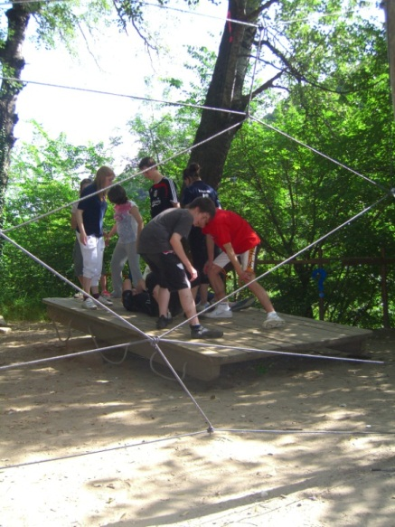
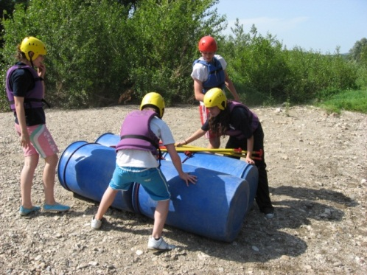

Slide 15
Communication Systems
Please make contact if you have any questions
via:
- telephone
- letter
- email year7@clere.hants.sch.uk
c.wheeler@clere.hants.sch.uk
We are always happy to make an appointment to talk about student progress and to ensure that there are no obstacles to success.

