Slide 1
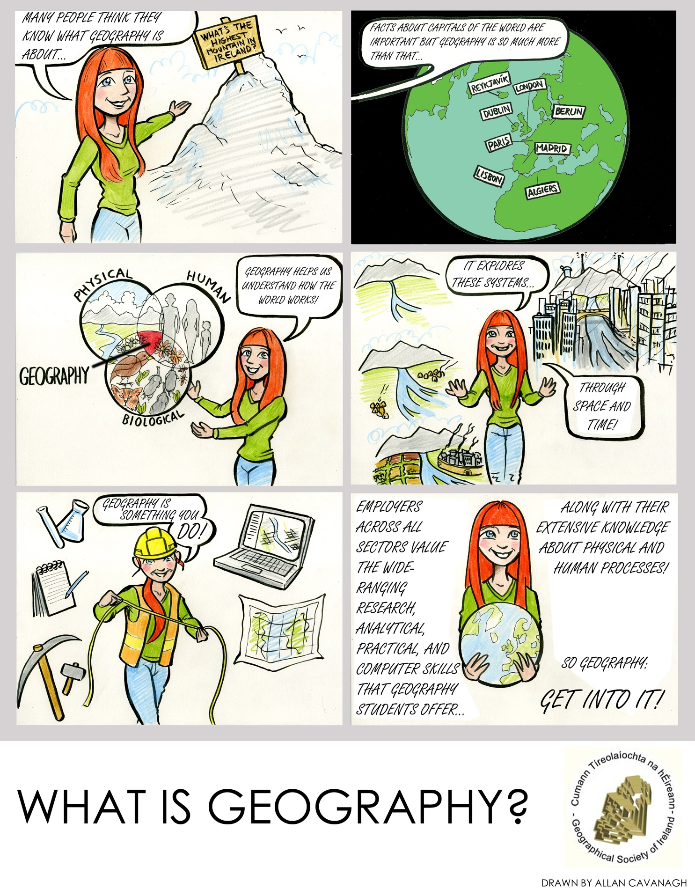
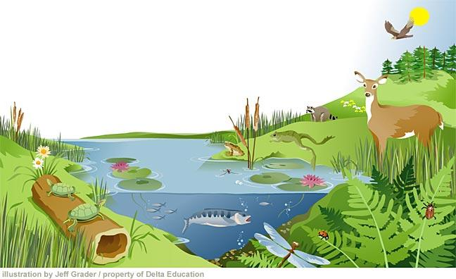
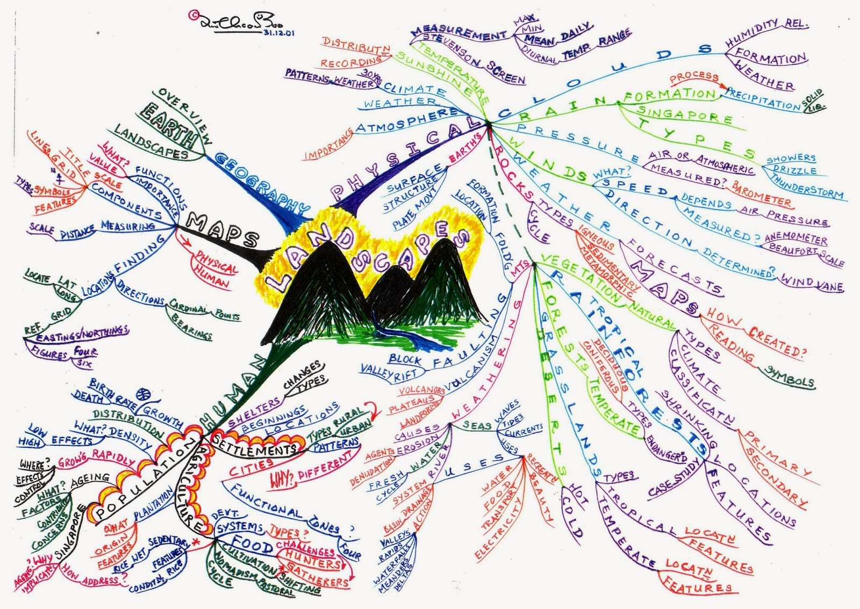
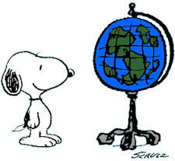
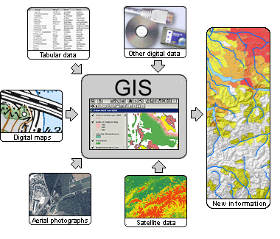
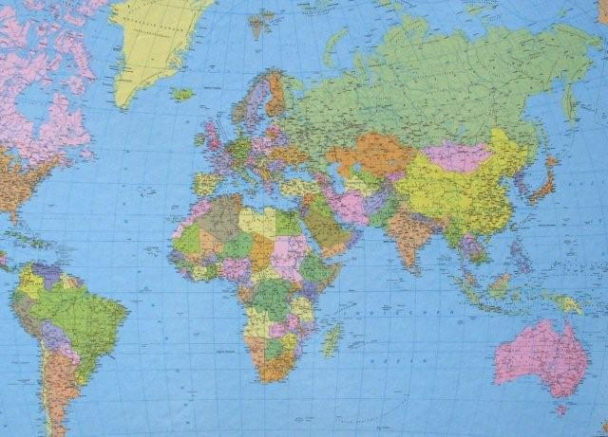
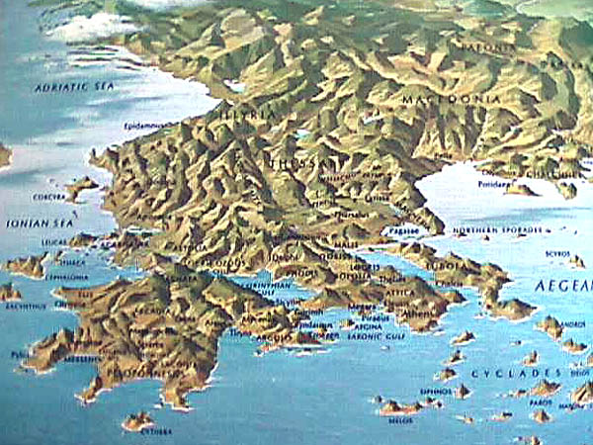
Introduction to Geography Overview
1. To gain an introduction to Geography.
2. What is Geography
3. Physical and Human Geography
4. Geography at Work
5. Where in the world
6. Geographers are Investigators.
7. Making Connections
9. Mystery Jobs.
8. Assessment

