Slide 1
Geography GCSE Revision guide

Slide 2
Contents
Revision Websites- Bitesize, Geography Revision, Internet Geography
Other Websites- BBC Earth, Royal Geographic society
You Tube
Revision Guides and Textbooks
AQA Website

Slide 3
BBC Bitesize

Slide 4
Geography Revision
Internet Geography

Slide 5
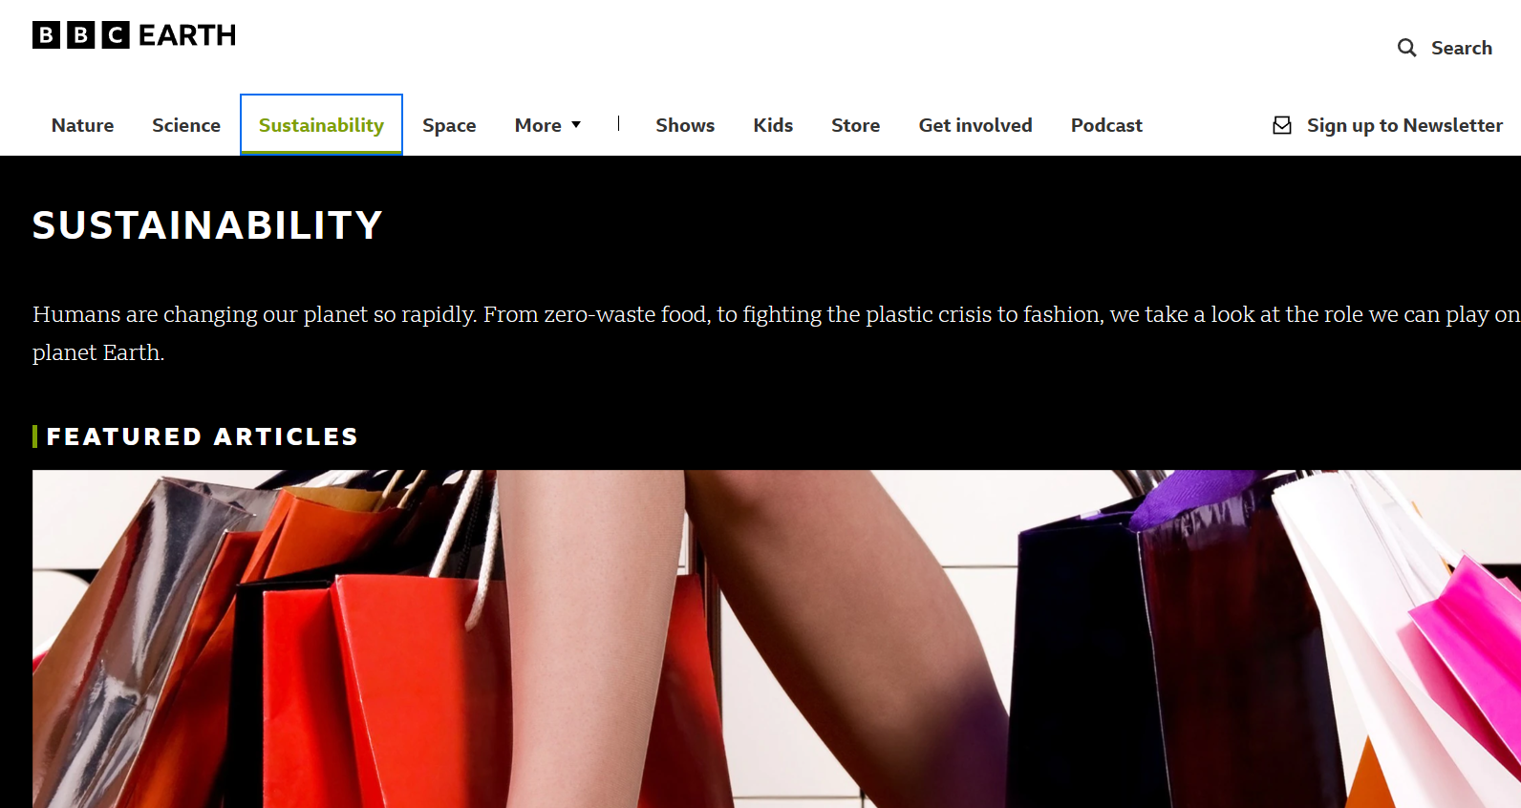
BBC Earth

Slide 6
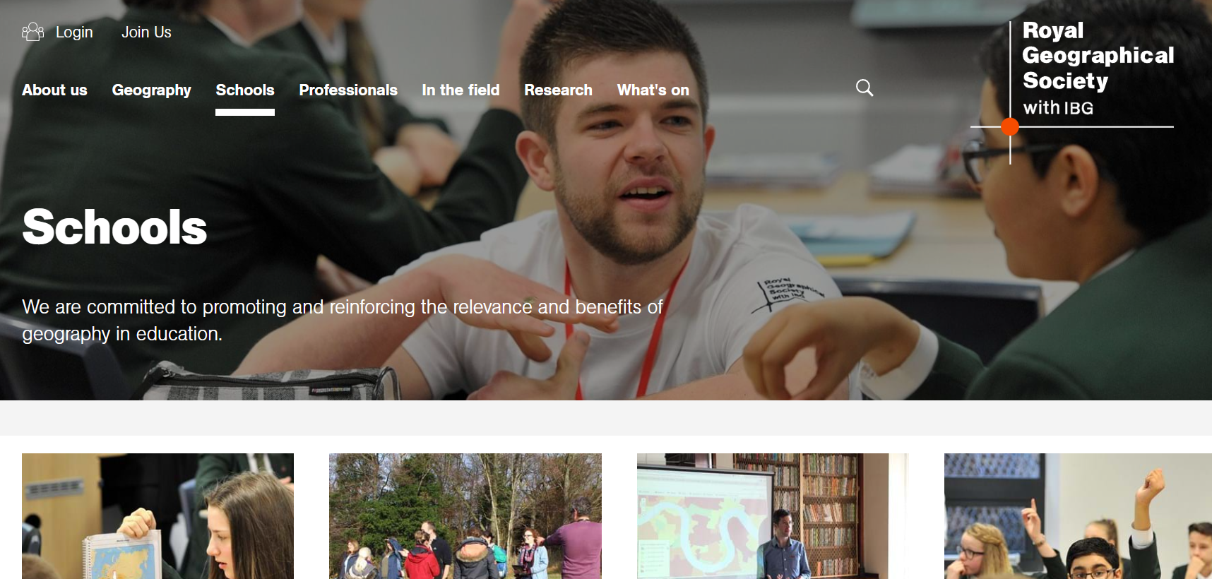
Royal Geographical Society

Slide 7
You Tube

Slide 8
Revision Guides

Slide 9
AQA Approved Textbooks

Slide 10
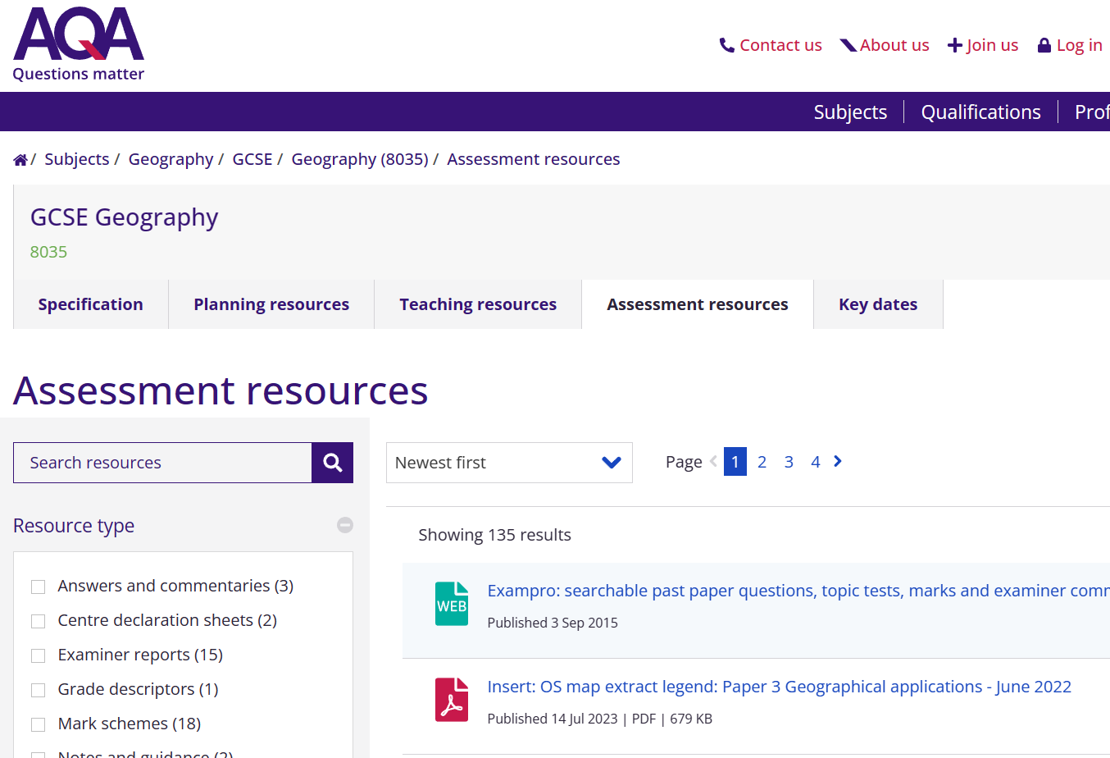
AQA Website

