Slide 1
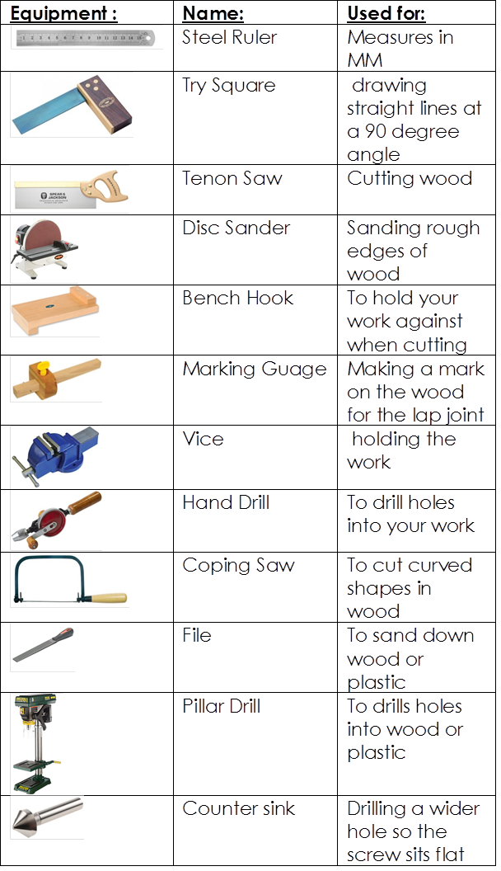
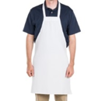
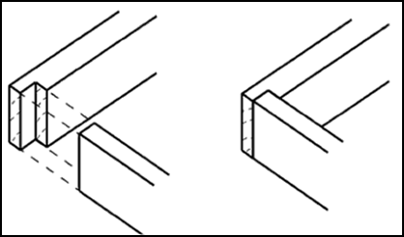
Knowledge Organiser Year 7 Pencil Box
Areas of focus
Health and safety
Designing
Development
Evaluation
Practical skills
Self/peer assessment
PPE
Health and Safety
Long hair tied back
No jewellery
Always wear an apron
Wear goggles
Bags under tables
Stools stacked away
Never run or throw things around the workshop
Never crowd round the machines
Always stand up when doing a practical
Overview of joints
Focus on lap joint
2D design | A computer software for designing
CAD | Computer-aided design. i.e 2D Design
CAM | Computer- aided Manufacture. i.e laser cutter
Hardwood | Hardwood is normally fruit bearing trees and those that loose their leaves in the winter. E.g Oak, Maple and Mahogany
Softwood | Softwood are trees that are always green and grow quickly. E.g Pine and Cedar
Man-Made | Man-Made wood is wood that’s not made naturally. E.g MDF, Plywood,

