Slide 1
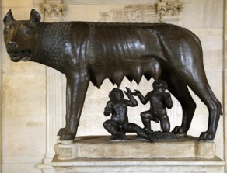
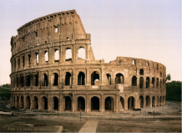
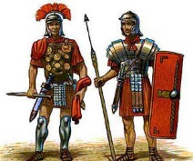
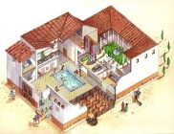
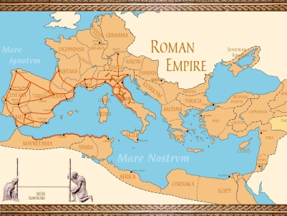
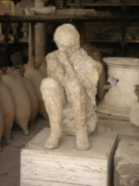
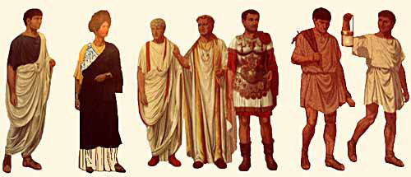
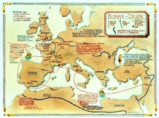
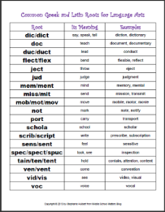
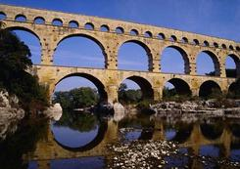
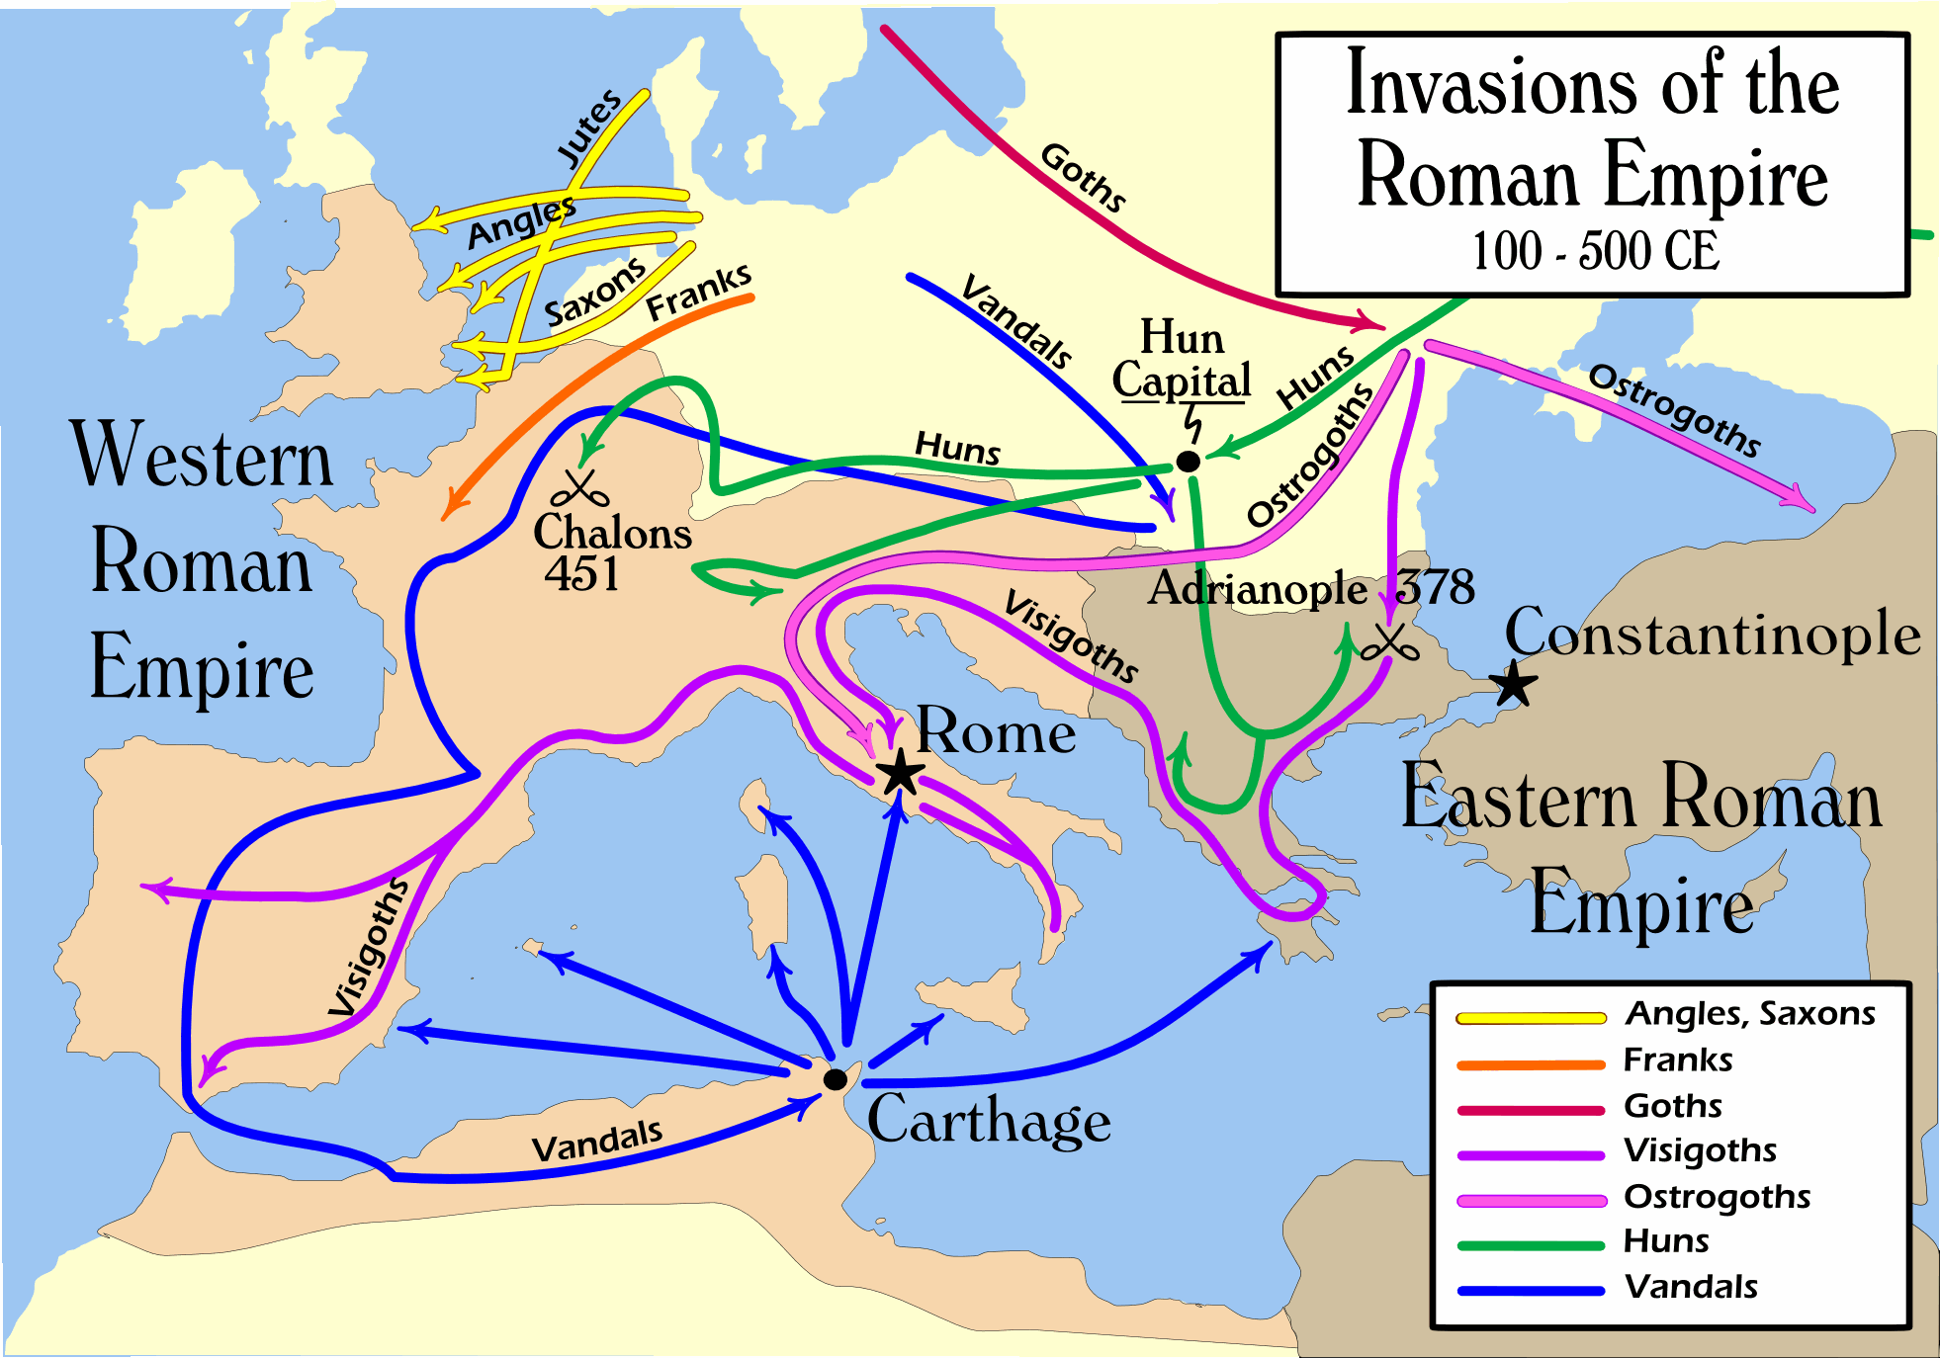
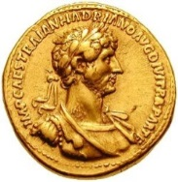
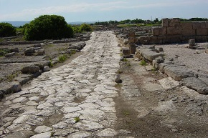
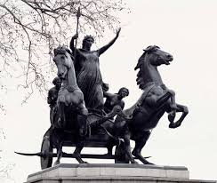
Year 7 Term 1: The Rise and Fall of the Roman Empire 753BC – AD 455
Key Events
1. 753 BC – Foundation of Rome
2. 509BC – Rome becomes a Republic
3. 250BC – Rome controls most of Italy
4. 217BC – Hannibal invades Rome
5. 55BC – Julius Caesar comes to Britain
6. 44BC – Julius Caesar is killed
7. 27BC – Augustus becomes Emperor
8. AD43 – Romans invade Britain
9. AD60 – Boudicca’s revolt
10. AD79 – Pompeii destroyed by eruption
11. AD117 – Hadrian’s Wall built
12. 455AD – Rome destroyed by Barbarian tribes
The Origins of Rome
Life in the Roman Empire
13. The Myth of Romulus & Remus
15. Baths
16. Colosseum
17. Games
18. Gladiators
20. Legion
21. Legionary
19. Chariot races
22. Javelin
25. Centurion
14. The expansion of the Empire
23. Testudo
26. Atrium
28. Pompeii
24. Century
27. Villa
30. Plebeians
29. Emperor
31. Senate
29. Vesuvius
32. Patrician
The Empire
The Fall of the Roman Empire
What have the Romans
done for us?
33. Trade with the provinces
35. The invasion of the Empire
34. Revolts
36. Language
37. Aqueducts
38. Currency
39. Roads

