Slide 1
Spanish
How to get the most of the time left before the final exams

Slide 2
How many exams are there to sit?
4 exams
1 for each skill
The 4 skills are: Listening, Speaking, Reading and Writing
Each one is worth 25% of the final grade

Slide 3
The LISTENING EXAM
Students should have the Pearson purple book
Using a mobile phone, students can access short listening tasks
Students can also access all listening exercises from the textbook via Kerboodle

Slide 4
THe speaking exam
It is essential that students speak aloud at home and in class on a weekly basis
It can be done by reading ALOUD texts , notes or pieces written
If they can write it, they can read it
If they can read it, they can speak it
Exam consists of 3 parts: a role-play ( situational conversation), a photo card to describe and a general conversation task ( 2 parts to it)
Students will have prepared a range of questions in class which will be used for the conversation part ( speaking booklets will be issued later in the year)

Slide 5
The reading exam
Pupils will need to have knowledge of all topics covered at KS3 and KS4
Texts come from a range of sources
In class, reading techniques – how to deal with unpredictable vocab etc.
At home, practise using past papers – use marking scheme to check correct answers

Slide 6
THE WRITING EXAM
Mini-essays in class to prepare for this task
Writing tasks divided into bullet points
Each bullet point must be answered in one or two lines and then developed further for extra marks
Translation task: short sentences or a short paragraph to translate – must be as accurate as possible to get maximum marks
Every translated segment / chunk counts so important to try and not leave any blanks

Slide 7
Revision sessions
Every Tuesday 3:00 to 3:30 in the MFL department
We will be working on specific points as well as going back over previous topics
Students can choose what they want to revise, get better at

Slide 8
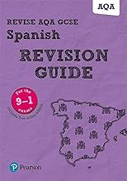
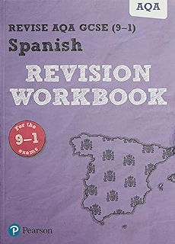
Resources
Pearson revision guide: use it to make revision cards, revise topics covered at KS3 and for relevant topical vocab
Pearson revision workbook: use it to practise listening, reading and writing skills
Memrise: all students to complete independently the following course to support their studies
Foundation: AQA GCSE Spanish 9-1 - by barcenae - Memrise
Higher: AQA GCSE Spanish (9-1 HIgher) - by easpain - Memrise

